Slide 1
Mycar Dream Assignment SUBMISSION
N Srinivas
DDA1610009

Slide 2
Understanding the Business Problem
The Consultancy company, MyCar Dream, would like to help its customers pick a car of their choice.
To maximize the customer satisfaction, they would like to predict the city-cycle fuel consumption in miles per gallon based on the dataset obtained by the consultancy company.
So what do we do now?
We would like to create a model based on the independent variables in the dataset to predict the mileage of the cars.
The developed model should be able to predict the results with 80% accuracy.

Slide 3
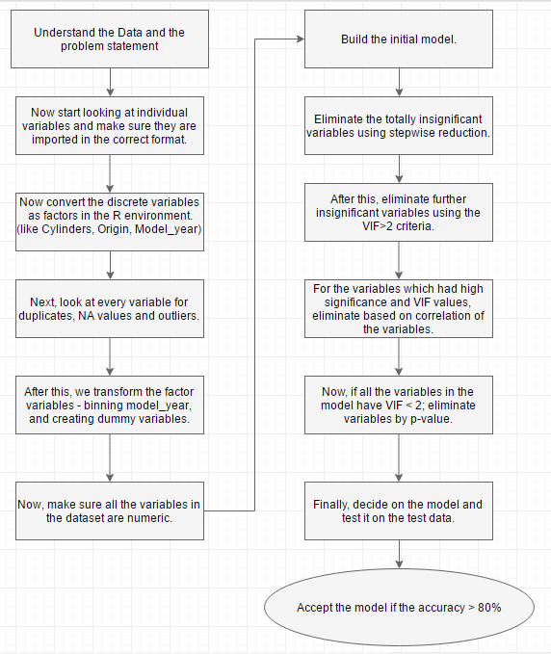
Problem solving methodology

Slide 4
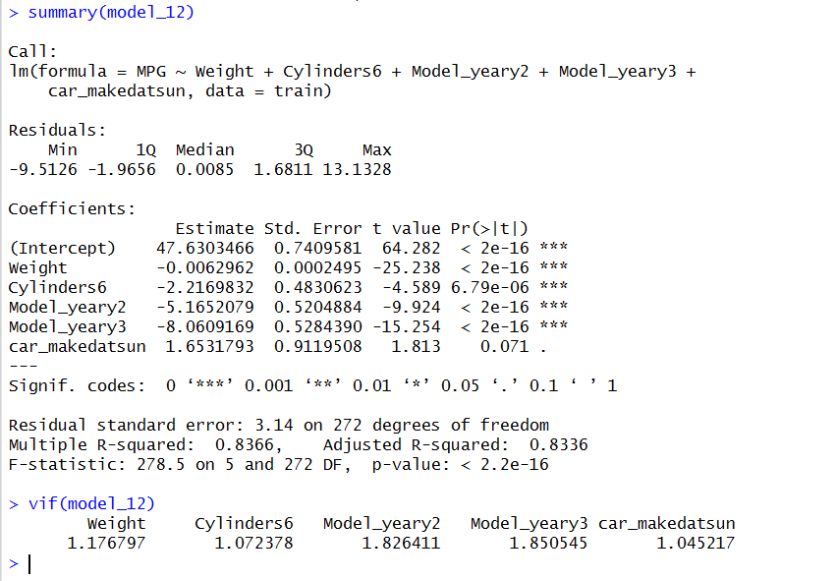
Model Results
Mathematically,
Mpg = 47.63 – 0.006296(weight) – 2.21(Cylinder6) – 5.165(model_yeary2) – 8.061(model_yeary3) + 1.653(car_makedatsun)

Slide 5
Model Results
Adjusted R-squared values of the Model
Adjusted R-squared values of the Prediction
0.8336 or 83.36%
0.83244 or 83.24%

Slide 6
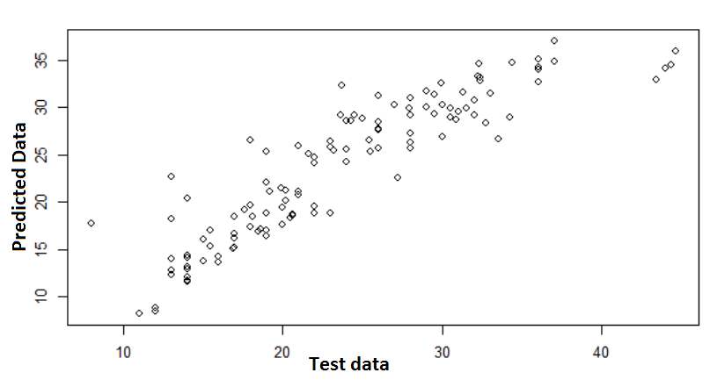
Plot of the predicted vs test data

Slide 7
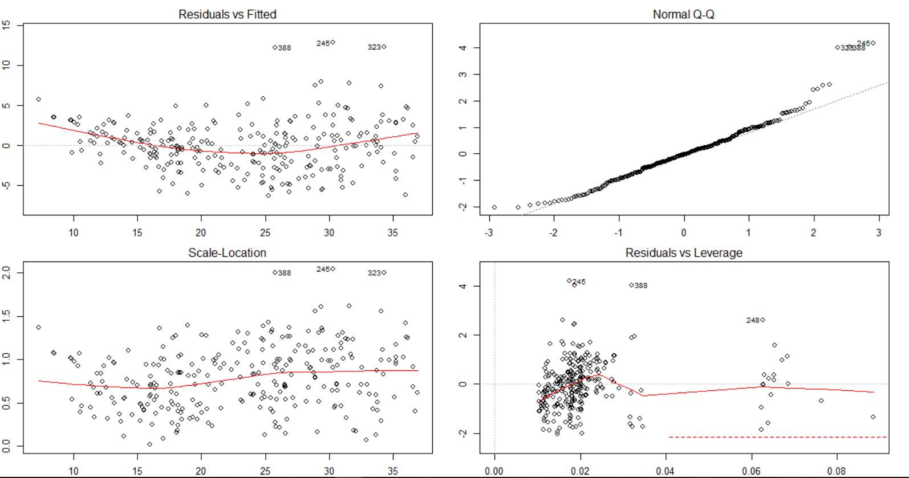
Residual plots

Slide 8
Conclusions
The developed model can be used to predict the miles per gallon i.e. the mileage of a car given the following details :
year or make,
Weight of the car
If it is a 6 cylindered car
And if it is Datsun make.
With the help of the above four parameters, it can be predicted to 83.24% accuracy, what the mileage of the car will be within the city.

